Slide 1
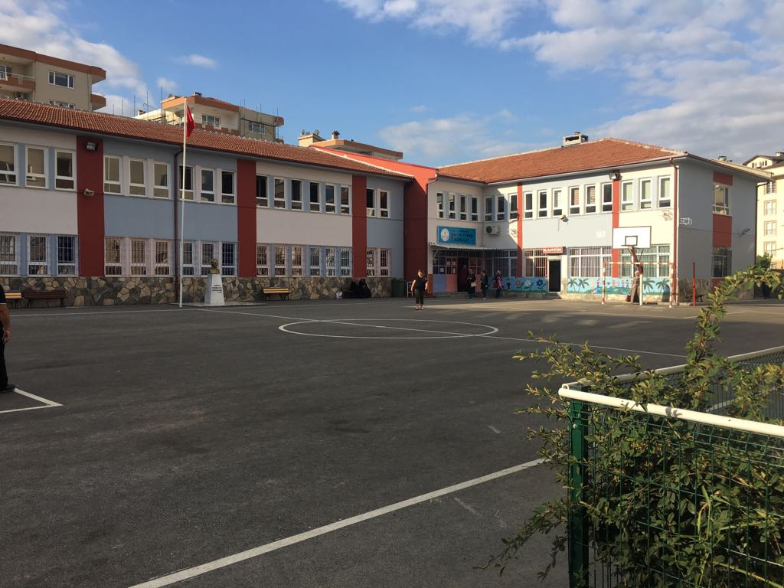
OUR SCHOOL
CAFER YENER PRIMARY SCHOOL

Slide 2
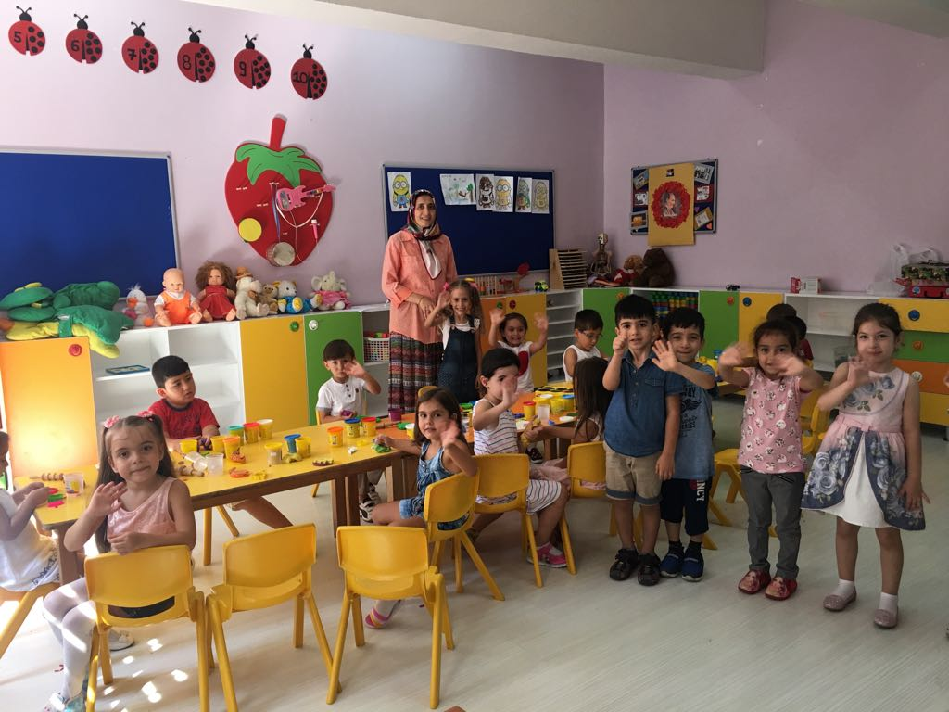
CLASSROOMS
PRE-SCHOOL

Slide 3
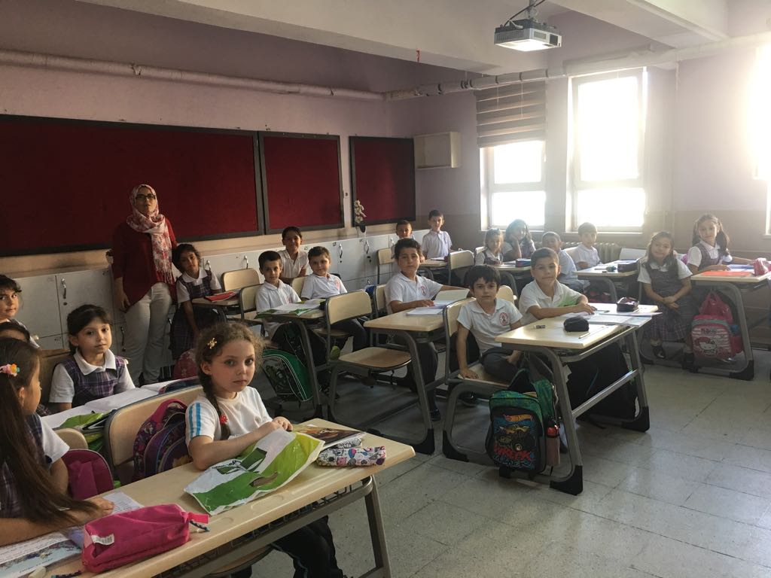
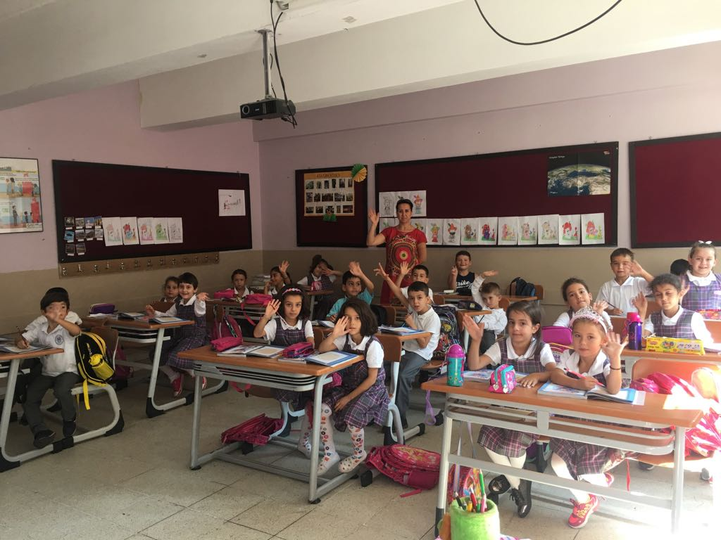
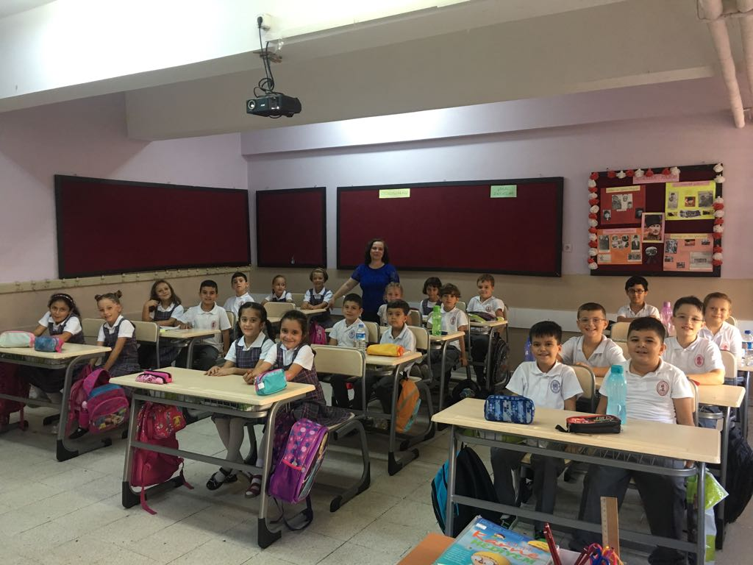
CLASSROOMS

Slide 4
ELT CLASSROOM

Slide 5
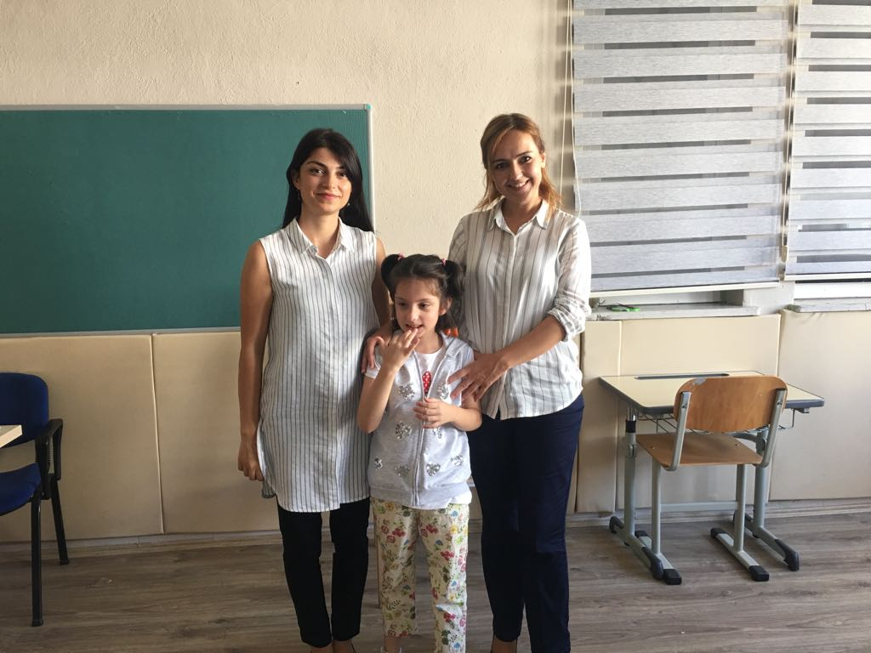
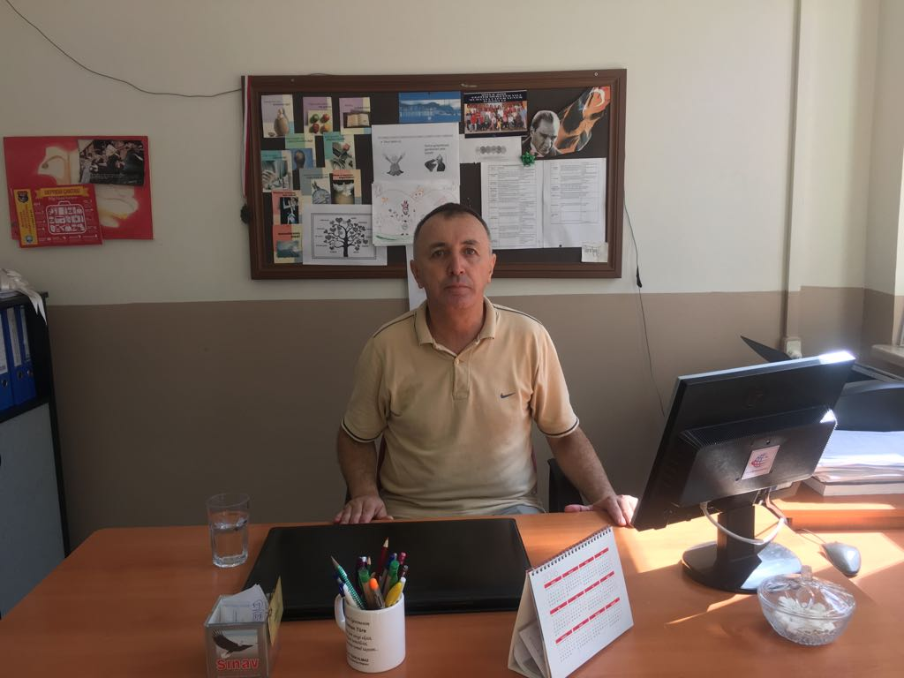
SPECIAL EDUCATION CLASSES
GUIDANCE COUNSELOR

Slide 6
STAFF ROOM

Slide 7
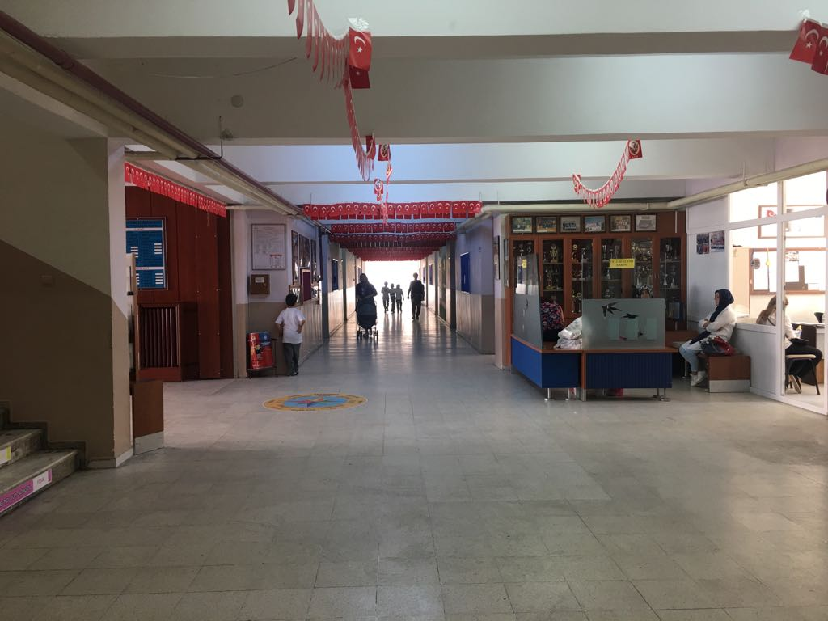
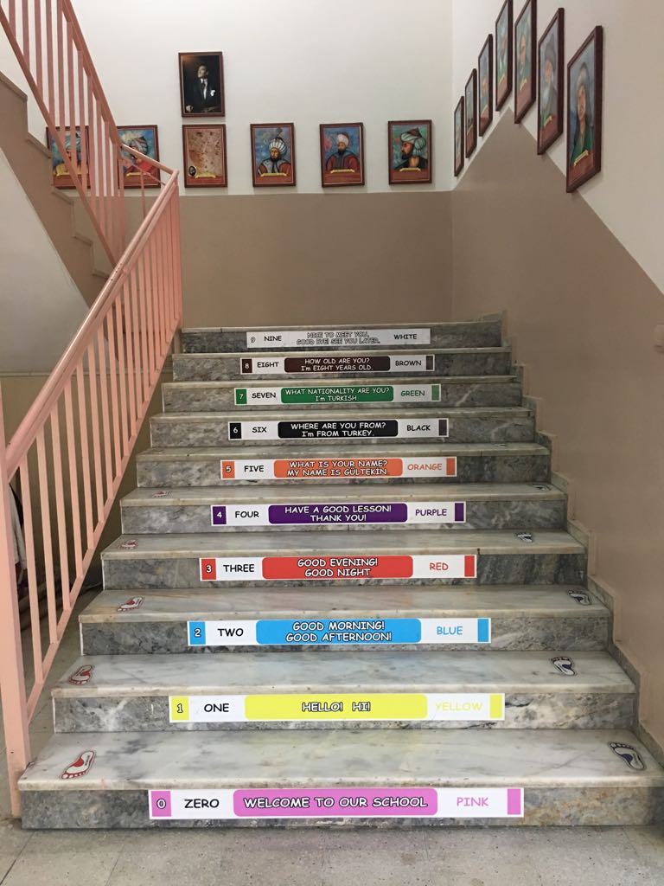

Slide 8
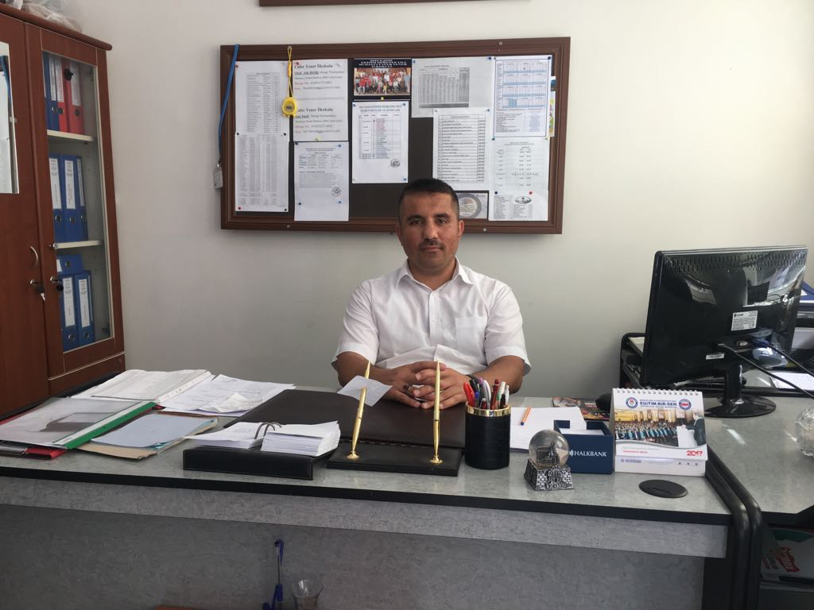
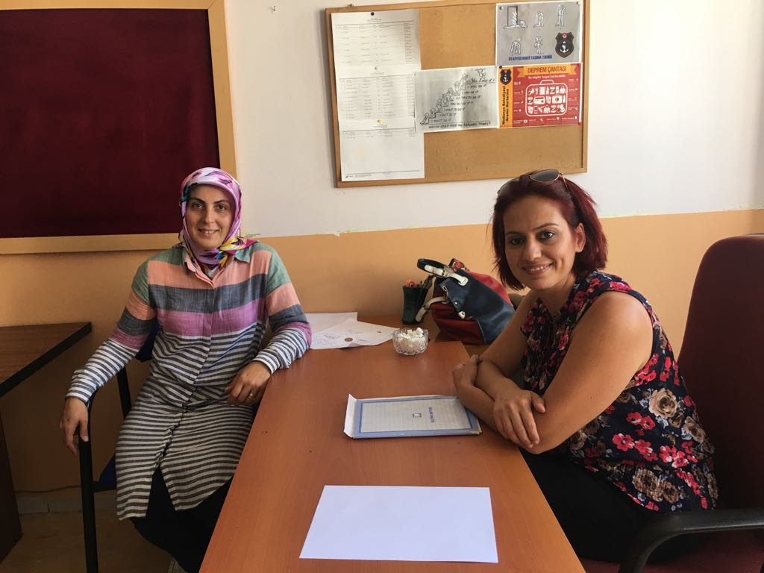
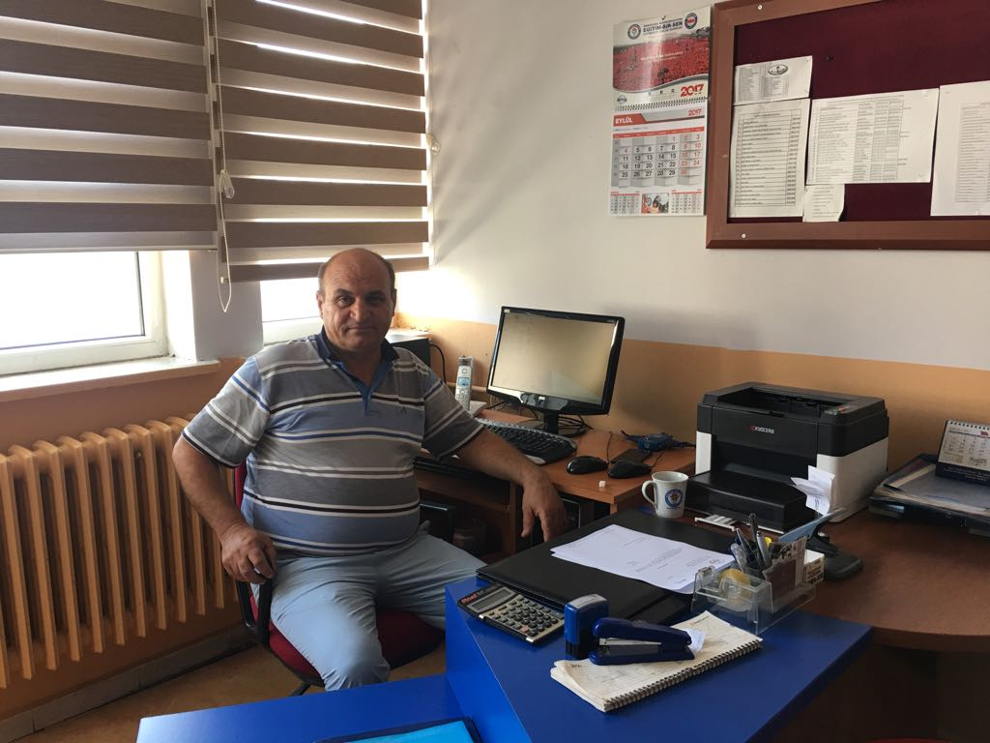
ADMINISTRATIVE STAFF
HEADMASTER
HEADMASTER ASSISTANT
SCHOOL-FAMILY UNION
OFFICER

Slide 9
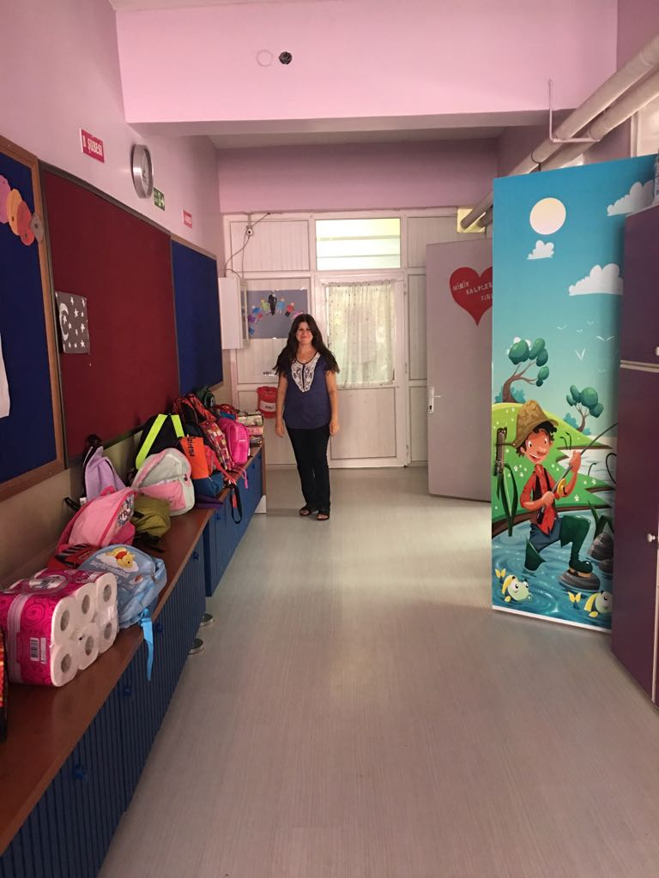
CARETAKERS- SERVANT STAFF

Slide 10
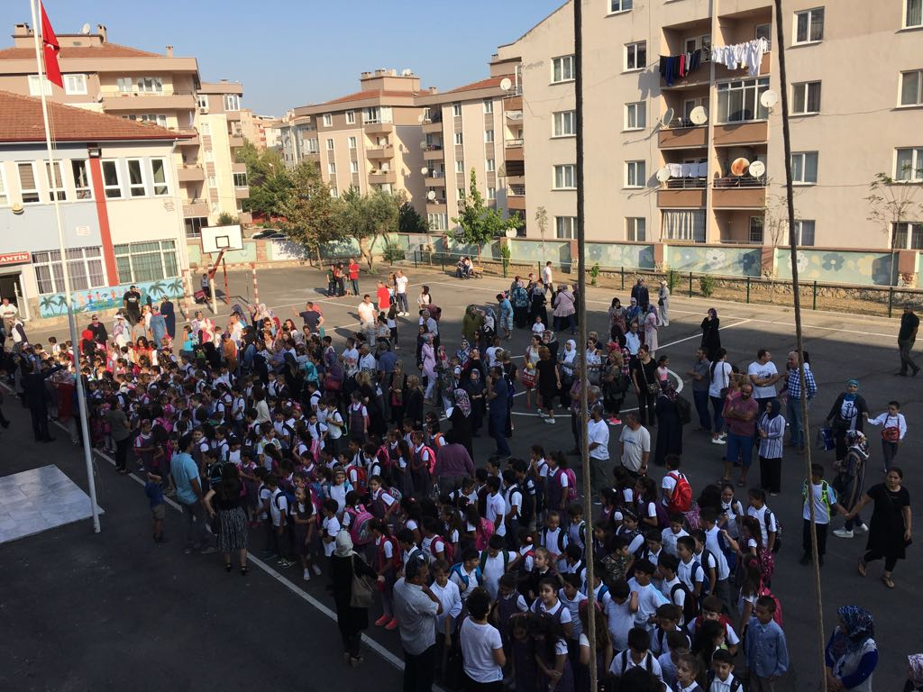
PUPILS

Slide 11
EU PROJECTS TEAM

